Slide 1
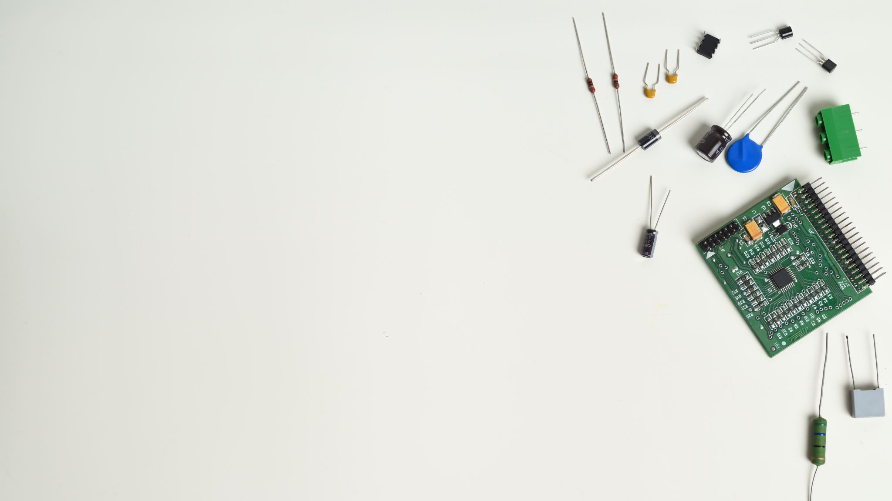
IOT-Application In engineering field 414469A
THE ESSENTIALS OF IoT FOR MODERN ENGINEERS

Slide 2
TABLE OF CONTENTS
01: INTRODUCTION • The IoT revolution
• Smart products
• The smart product mechanical engineer
02: WHAT IS IoT?
• Consumer IoT
• Industrial IoT
• Sense. Analyze. Connect. Exchange.
03: HOW DOES IoT WORK?
• The IoT process
• Product components
• Sensors • Connectivity
• Cloud • External sources
• Data visualization

Slide 3
TABLE OF CONTENTS
04: WHY DOES IoT MATTER?
• Better products, better world.
• Closed loop design
• Key takeaways for engineers
05: CONCLUSION
•Summary

Slide 4
INTRODUCTION
The IoT revolution
By now you’ve probably heard the hype surrounding the Internet of Things (IoT) and smart products. In a way, it’s analogous to the dawn of the desktop computer. Maybe the notion that computers would populate desks seemed implausible at first, but the new technology had significant impacts in time - everyone has some kind of desktop or portable device today. The Internet of Things may feel like an overused term, but it has real benefits for engineers, businesses, and consumers. IoT introduces countless opportunities to disrupt the status quo across top industries with reimagined products. It offers enormous quantities of product performance data, functions that improve consumer experiences, predictive maintenance possibilities, and new service lines, each paving new avenues for engineers to design better products. In an increasingly connected world, engineers are uniquely positioned to steer the course of innovation by embracing IoT.

Slide 5
INTRODUCTION…
Smart products
In the United States alone, there are about 256,363 manufacturing firms.3 That’s a lot of products being engineered and manufactured. With the Internet of Things, those products (and the machines that make them) can communicate with you, their surroundings, and each other. Products are finding their voices, and it turns out they have a lot to say. Smart products can...
• Sense their environment by collecting data about their surroundings
• Analyze big data and perform computations through software
• Connect to other things, allowing them to…
• Exchange data and commands with other things
The Internet of Things is constructing a future with an infrastructure of billions of smart, connected products – products that leverage data and communicate with each other to operate with increased productivity and efficiency.
Things are getting smarter. Are you?

Slide 6
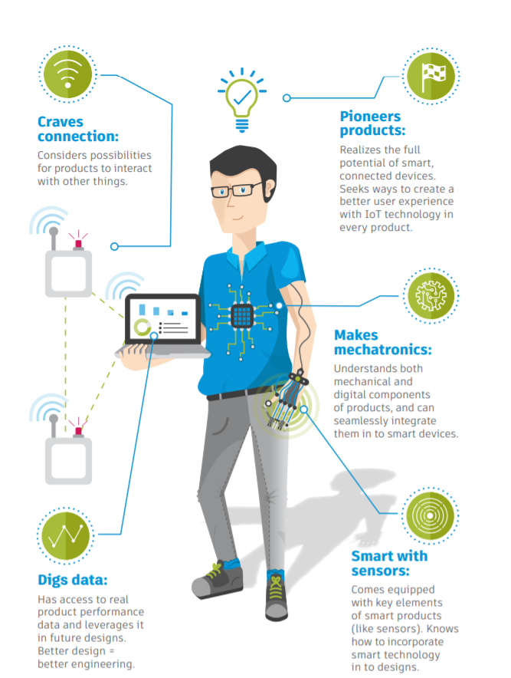
INTRODUCTION…
The smart product mechanical engineer
IoT is inevitably changing how engineers design products. While the mechanical engineer of the future needs the same foundation of technical skills and savvy for creative problem-solving as always, additional characteristics will soon be necessary.

Slide 7
WHAT IS IoT?
IoT is an industry buzzword, but what does it mean? Loosely, the Internet of Things references the growing network of smart, connected products. This network is impacting top industries and changing how things are designed, made, and used.

Slide 8
WHAT IS IoT?...
Consumer IoT
Any product directly used by a consumer is part of the consumer IoT. Some consumer products are already widely used, such as fitness tracking devices, smart watches, and home products (think of the Nest thermostat or the Apple Home Kit). It’s predicted that in 2016, 33% of adults will use some form of IoT in their home, as a wearable, or in their car, and this group is only expected to grow.

Slide 9
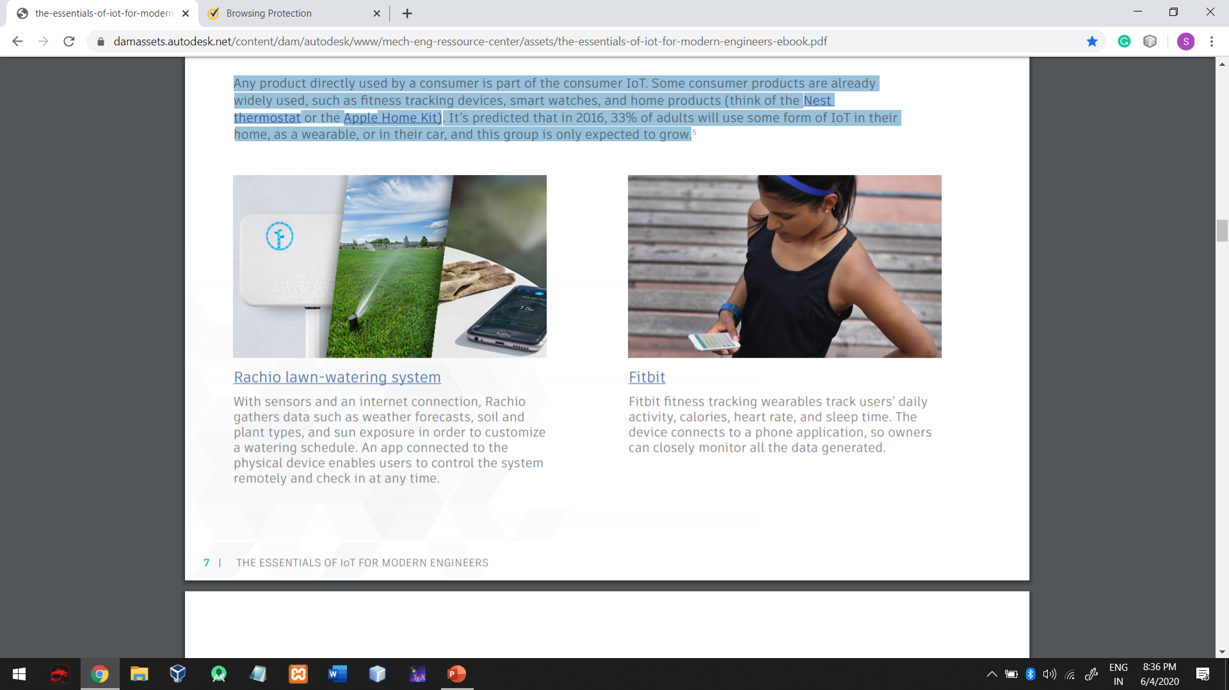
Rachio lawn-watering system
With sensors and an internet connection, Rachio gathers data such as weather forecasts, soil and plant types, and sun exposure in order to customize a watering schedule. An app connected to the physical device enables users to control the system remotely and check in at any time.

Slide 10
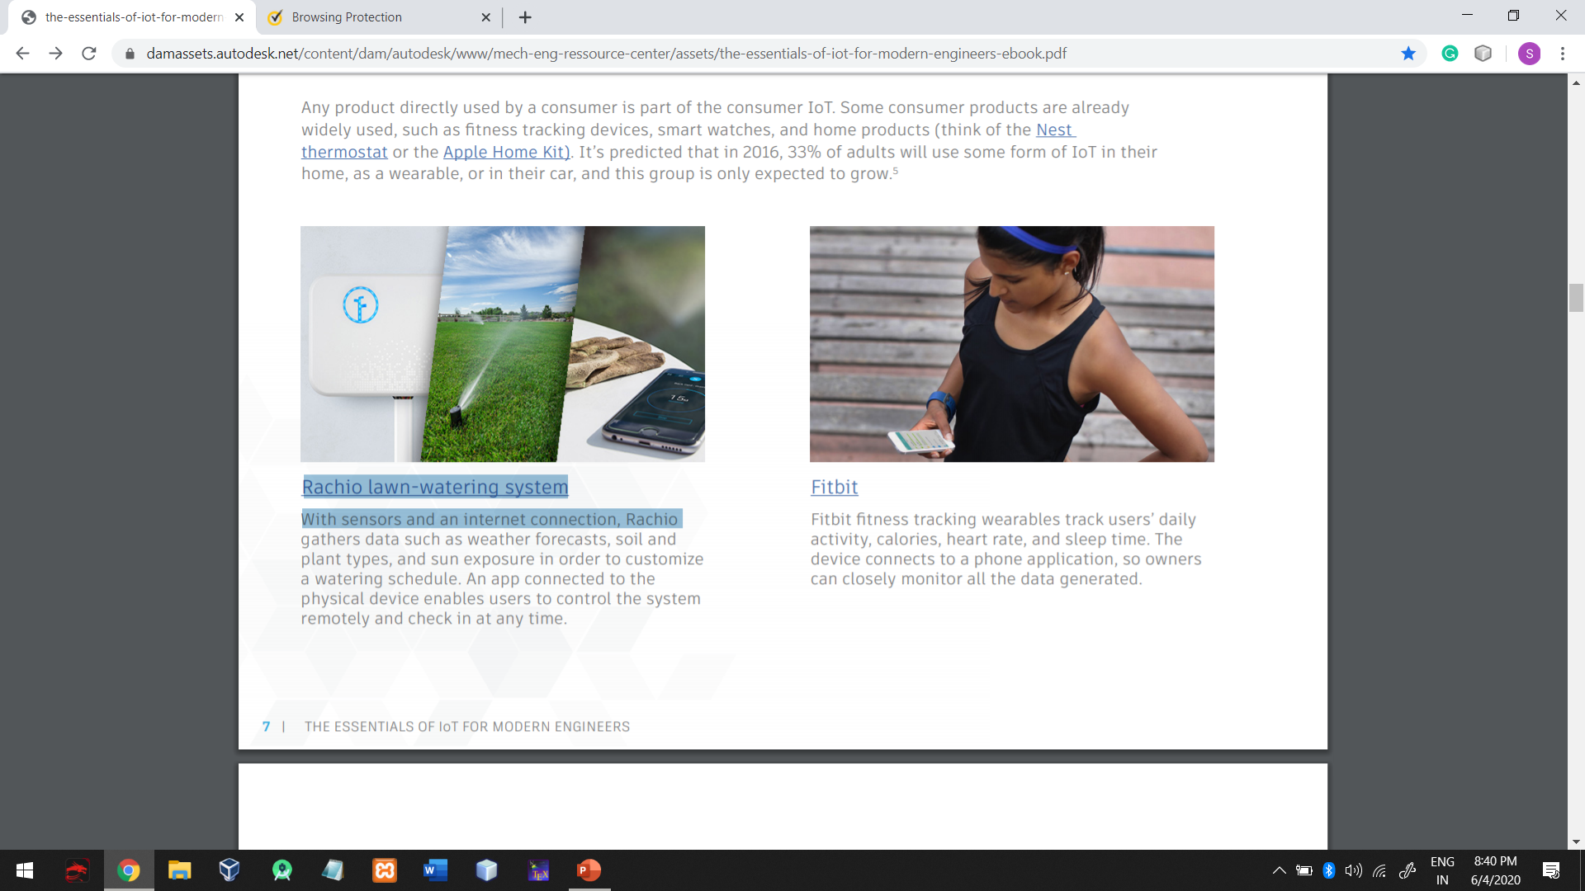
Fitbit
Fitbit fitness tracking wearables track users’ daily activity, calories, heart rate, and sleep time. The device connects to a phone application, so owners can closely monitor all the data generated.

Slide 11
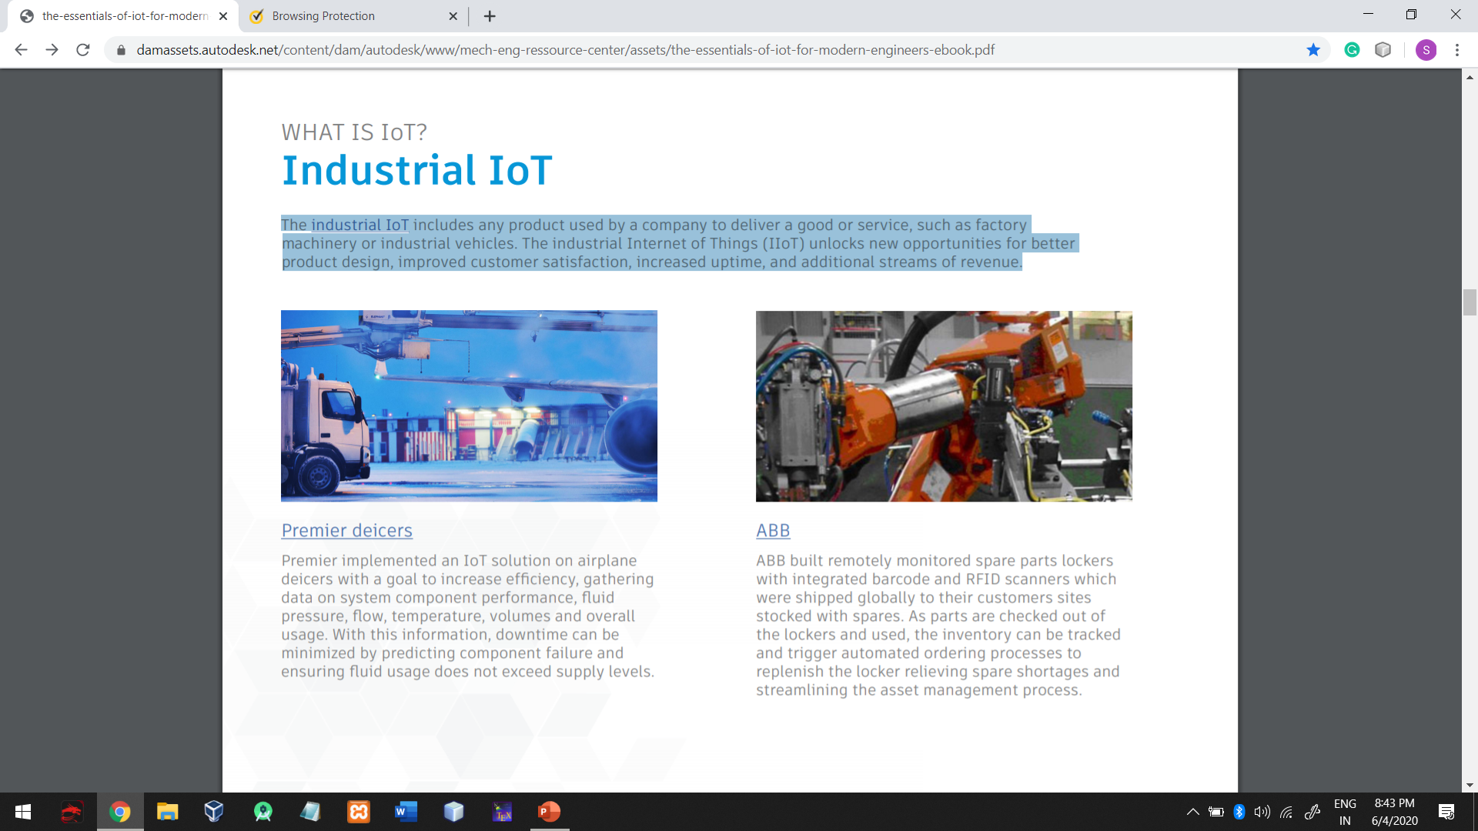
WHAT IS IoT?...
Industrial IoT
The industrial IoT includes any product used by a company to deliver a good or service, such as factory machinery or industrial vehicles. The industrial Internet of Things (IIoT) unlocks new opportunities for better product design, improved customer satisfaction, increased uptime, and additional streams of revenue.

Slide 12
WHAT IS IoT?... Sense. Analyze. Connect. Exchange.
The Internet of Things as it is known today had an inconspicuous start in 1999 with a tube of lipstick. Kevin Ashton of Procter & Gamble noticed that when he visited stores, one shade of P&G lipstick was always sold out. To understand why lipstick couldn’t stay stocked, Ashton had an idea: attach a RFID tag to the product, collect data from it with a wireless router, and use it to tell stores what’s on the shelf. He coined the phrase the “Internet of Things” to refer to the network of devices connected to the internet that can collect and exchange data with the goal of achieving a better product experience. IoT is far from limited to drugstore shelves, with applications fundamentally transforming industries. In fact, the most valuable uses of IoT are found in the industrial rather than the consumer realm.

Slide 13
HOW DOES IoT WORK?
What makes a smart product so smart? IoT devices have several unique features that set them apart from non-connected products.

Slide 14
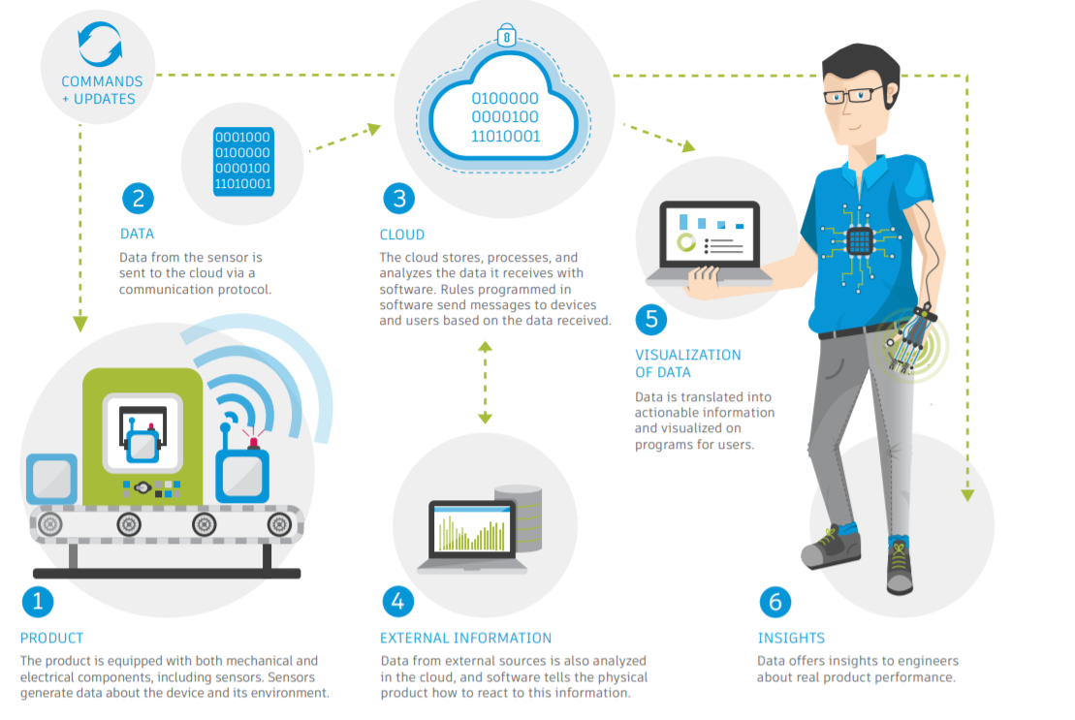
HOW DOES IoT WORK?... The IOT PROCESS

Slide 15
HOW DOES IoT WORK?... Product components
The physical IoT product consists of mechanical hardware, electrical hardware, and software. Besides the mechanical enclosure of the product, there are key electronic aspects including sensors, data storage devices, and control software. These components are what make the “smart” part of smart products possible.

Slide 16
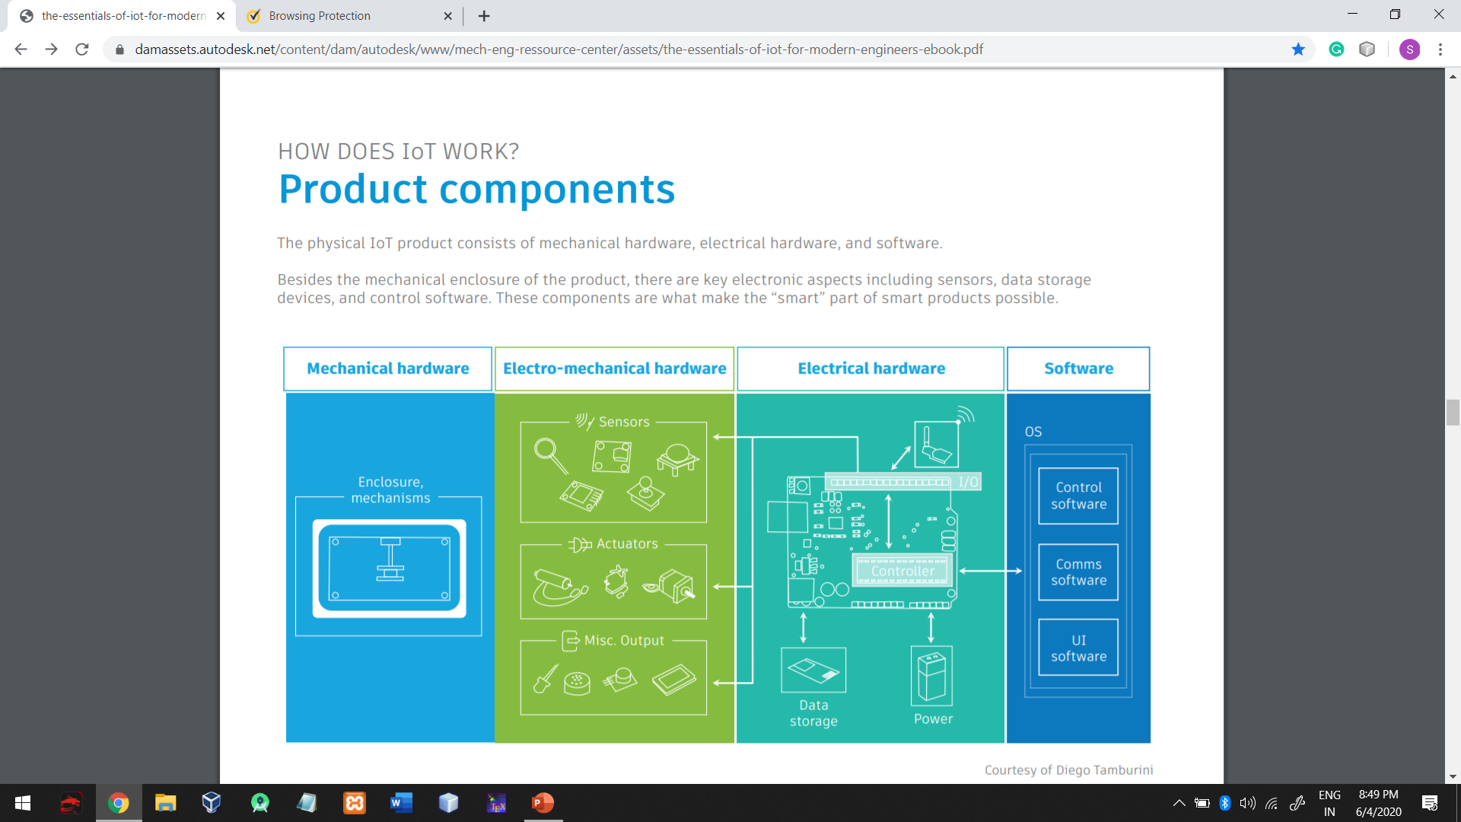
Product components

Slide 17
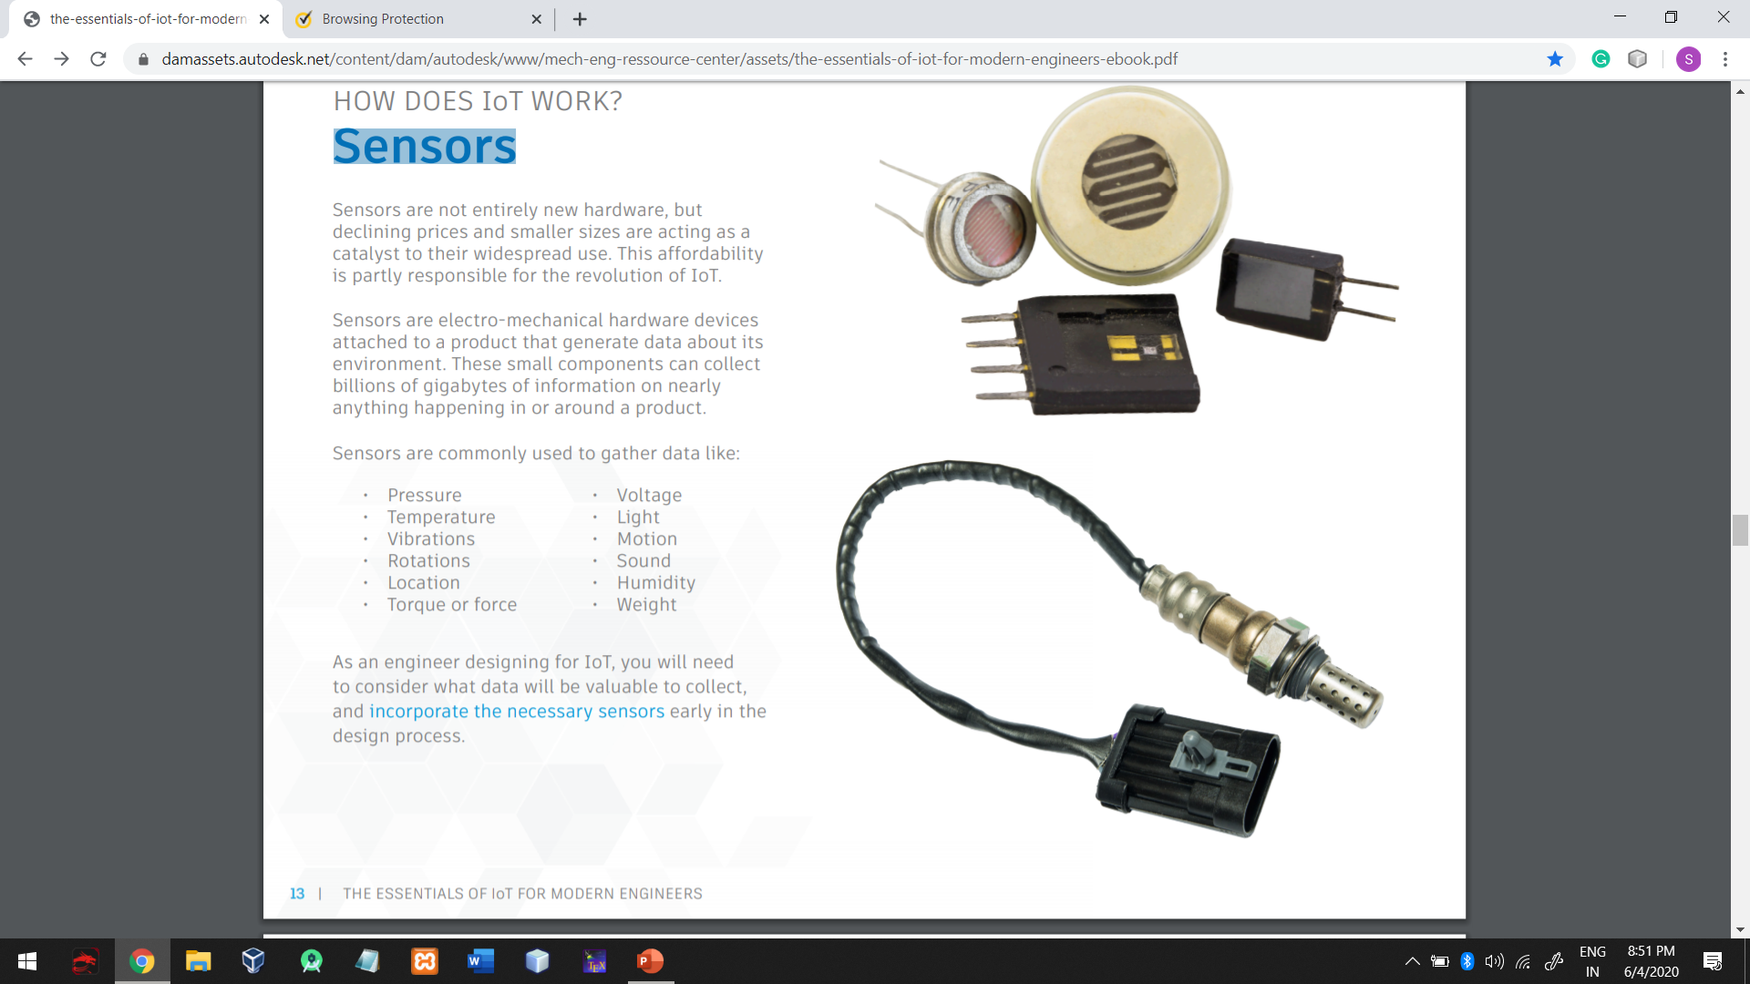
HOW DOES IoT WORK?... Sensors
Sensors are not entirely new hardware, but declining prices and smaller sizes are acting as a catalyst to their widespread use. This affordability is partly responsible for the revolution of IoT. Sensors are electro-mechanical hardware devices attached to a product that generate data about its environment. These small components can collect billions of gigabytes of information on nearly anything happening in or around a product. Sensors are commonly used to gather data like:
• Pressure
• Temperature
• Vibrations
• Rotations
• Location
• Torque or force
• Voltage
• Light
• Motion
• Sound
• Humidity
• Weight
As an engineer designing for IoT, you will need to consider what data will be valuable to collect, and incorporate the necessary sensors early in the design process.

Slide 18
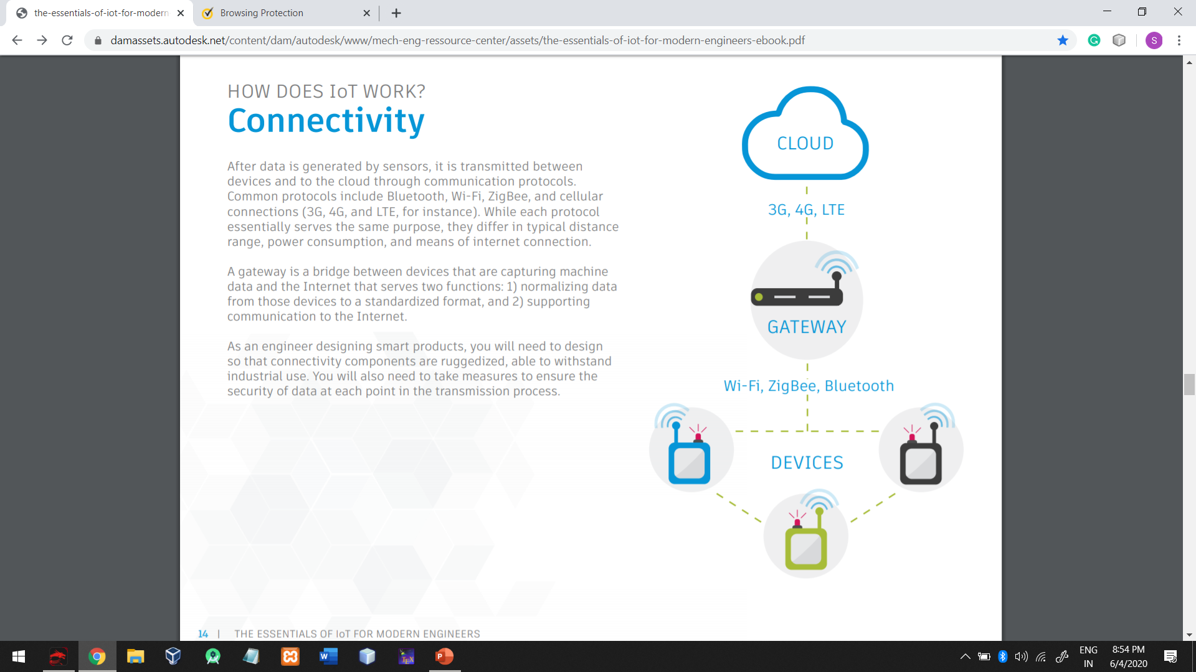
HOW DOES IoT WORK?... Connectivity
After data is generated by sensors, it is transmitted between devices and to the cloud through communication protocols. Common protocols include Bluetooth, Wi-Fi, ZigBee, and cellular connections (3G, 4G, and LTE, for instance). While each protocol essentially serves the same purpose, they differ in typical distance range, power consumption, and means of internet connection.
A gateway is a bridge between devices that are capturing machine data and the Internet that serves two functions: 1) normalizing data from those devices to a standardized format, and 2) supporting communication to the Internet.
As an engineer designing smart products, you will need to design so that connectivity components are ruggedized, able to withstand industrial use. You will also need to take measures to ensure the security of data at each point in the transmission process.

Slide 19
HOW DOES IoT WORK?... Cloud
The massive amount of data generated by smart products is transmitted from the products to the cloud, the storage and computing facet of the device. In the cloud, data is securely stored, processed, and analyzed. It operates remotely and has basically unlimited storage capacities. The IoT cloud component consists of software, a big data engine, an application platform, and a database. • The software is the boss of the operation, monitoring and controlling product functions. Software adds value to hardware by converting unorganized data into actionable information • The big data engine crunches the numbers – it analyzes incoming data and uncovers product insights. • The application platform organizes and presents information – it enables visualization and access to data so users can see what their product is saying. • The database stores information, aggregating and managing incoming data in real time.

Slide 20
HOW DOES IoT WORK?... External Sources
Also informing the cloud are external sources, including internet resources and business systems. External sources input information from the internet such as the weather, traffic, prices, social media, and maps. Business systems like CRM and PLM systems can also be integrated with the cloud. This additional data is processed in the cloud along with data from sensors, all of which reveal further insights about product performance. The incorporation of external sources into big data analysis feeds engineers additional information about the conditions surrounding a product. You can make decisions about the product’s operation based on this information, such as designing a machine to shut down when weather conditions decrease its efficiency.

Slide 21
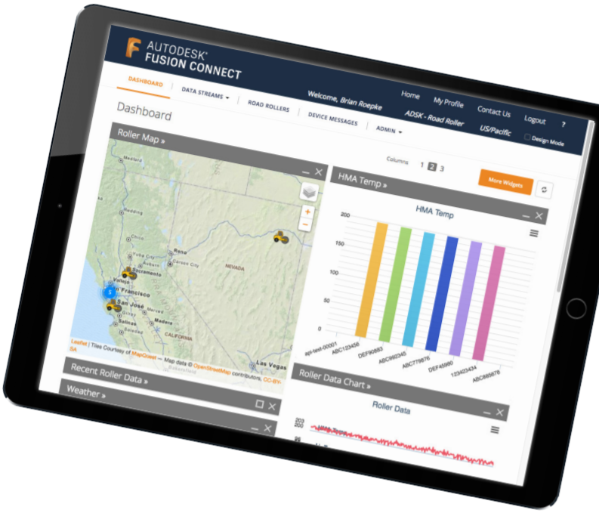
HOW DOES IoT WORK? Data visualization
Data visualization platforms allow users to view information about the product and control it remotely. These platforms create digital twins of the physical product, displaying information about the product’s conditons. They typically allow users to see trends in the operation of their products, compare devices, and track data points. Users can act upon information by sending signals through the cloud to the product, commanding devices to perform various functions. With this kind of access, engineers gain a broader perspective of the product and how it is being used. You can track correlations in conditions and performance, and observe how modifying functions affects efficiency and productivity. These insights inform future designs, allowing you to make better products.

Slide 22
WHY DOES IoT MATTER?
The benefits of IoT are huge - for consumers, for businesses, and especially for engineers. Making an IoT product doesn’t just reward the end-user, but each player in the production process as well.

Slide 23
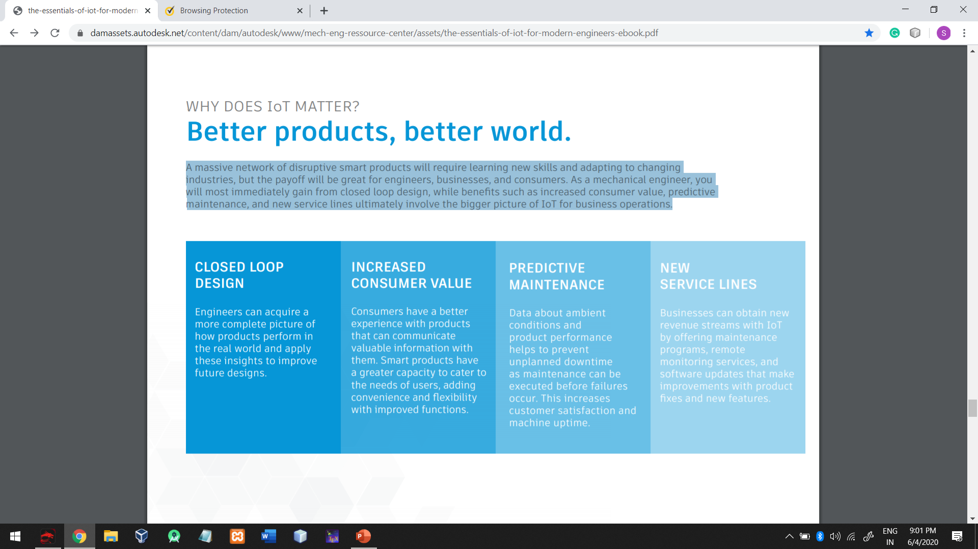
WHY DOES IoT MATTER?... Better products, better world.
A massive network of disruptive smart products will require learning new skills and adapting to changing industries, but the payoff will be great for engineers, businesses, and consumers. As a mechanical engineer, you will most immediately gain from closed loop design, while benefits such as increased consumer value, predictive maintenance, and new service lines ultimately involve the bigger picture of IoT for business operations.

Slide 24
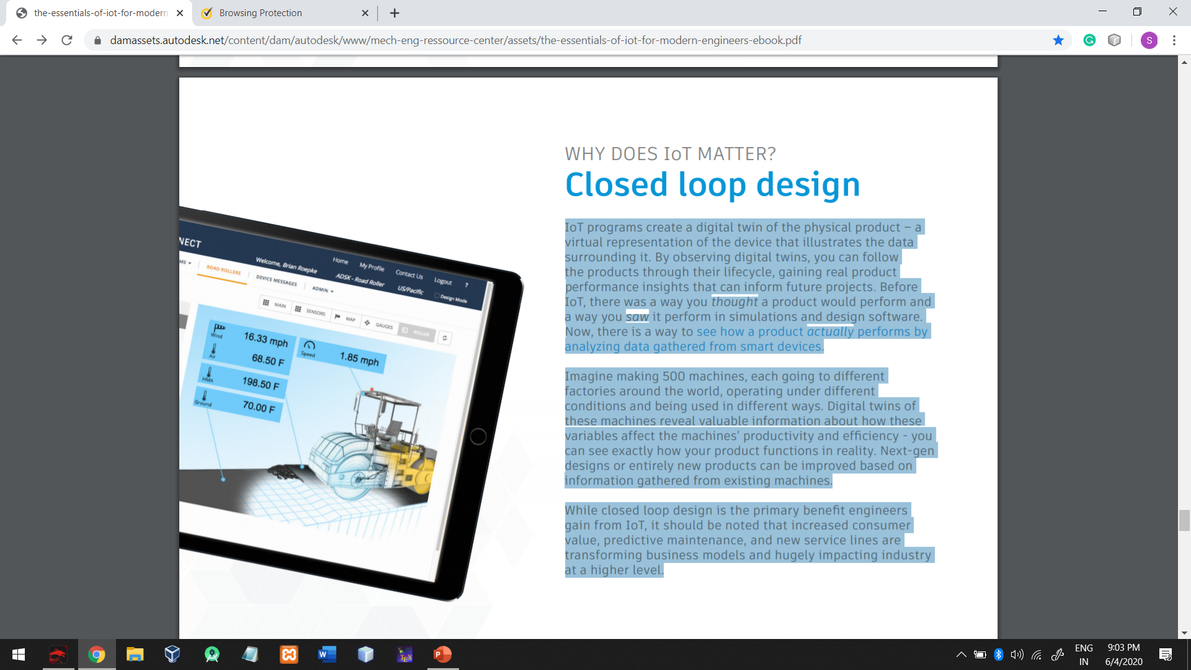
WHY DOES IoT MATTER?... Closed loop design
IoT programs create a digital twin of the physical product – a virtual representation of the device that illustrates the data surrounding it. By observing digital twins, you can follow the products through their lifecycle, gaining real product performance insights that can inform future projects. Before IoT, there was a way you thought a product would perform and a way you saw it perform in simulations and design software. Now, there is a way to see how a product actually performs by analyzing data gathered from smart devices. Imagine making 500 machines, each going to different factories around the world, operating under different conditions and being used in different ways. Digital twins of these machines reveal valuable information about how these variables affect the machines’ productivity and efficiency - you can see exactly how your product functions in reality. Next-gen designs or entirely new products can be improved based on information gathered from existing machines. While closed loop design is the primary benefit engineers gain from IoT, it should be noted that increased consumer value, predictive maintenance, and new service lines are transforming business models and hugely impacting industry at a higher level.

Slide 25
WHY DOES IoT MATTER?... Key takeaways for engineers
Mechanical engineers are positioned to be key players in the implementation of IoT into manufactured products. Remember these takeaways as you proceed with designing IoT devices:
Product design
• As you design, consider how data can help inform your projects, and incorporate appropriate sensors early in the process.
• Products must be designed so that software and hardware seamlessly complement each other. IoT is advancing connectivity, communication, and control from systems like PLC and SCADA to devices with more capabilities and integration of mechanical and electronic aspects.
• Design with upgrades in mind. When software is updated, mechanical aspects must be in place for the product to function correctly. Some mechanical functions might not be initially optimized, but these capabilities may be necessary when software is modified.

Slide 26
CONCLUSION
Summary
IoT is the growing network of connected products that is changing manufacturing at a scope comparable to the Industrial Revolution. This transformation of industry opens opportunities for engineers to make better products by integrating electrical and mechanical aspects in designs and leveraging big data. Closed loop design is the biggest benefit of IoT products for engineers, allowing you to follow products through their entire lifecycle. Insights gained from this system can result in future designs with improved functions and more capabilities. The role of the mechanical engineer is taking a new form, but initial hardships for engineers who dive in to IoT will undoubtedly give way to well-worthwhile benefits. Making things has never been more exciting.

Slide 27
PRESENTATION BY
SUBHASISH CHATTERJEE
BE-IT
Roll:02
Audit Course
Course Code: 414469A

